Slide 1
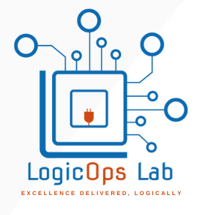
PROJECT #4 Real Time Dev Sec Ops
LogicOps Lab By Ravish
Notes:
© Copyright Showeet.com – Creative & Free PowerPoint Templates

Slide 2

About Me!
Ravish Rawat
10+ yrs of IT experience.
Well-versed in the architecting of DevOps solutions and SDLC including analysis, design, coding, scripting, testing, automation, version control, documentation, support, etc.
Believer of learning and giving back to the community.
LinkedIn - https://www.linkedin.com/in/rawwish/
GitHub - https://github.com/logicopslab
Notes:
© Copyright Showeet.com – Creative & Free PowerPoint Templates

Slide 3
Agenda / RoadMap
To achieve an end-to-end CI-CD pipeline
Using secrets management tools for sensitive information
01
04
Remove any manual intervention
Notification integration to know build status
02
05
Integrating security to our pipeline
Deploying the solution to VMs (Local or Public Cloud)
03
06
Notes:
© Copyright Showeet.com – Creative & Free PowerPoint Templates

Slide 4










Tech Stack
Jenkins
Hashicorp vault
A CI - CD tool
Secret management tool
Maven
JUnit
Build tool
Testing framework
Trivy
SonarQUBE
Code quality tool
Scanner for vulnerabilities
Dockerhub
Teams / Slack
Storing the images
Messaging tool
Notes:
© Copyright Showeet.com – Creative & Free PowerPoint Templates

Slide 5
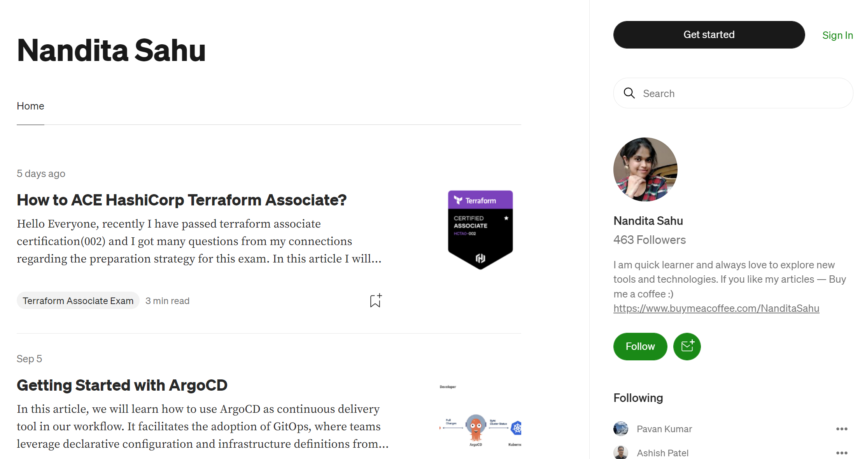
Credits
https://medium.com/@nanditasahu031
Notes:
© Copyright Showeet.com – Creative & Free PowerPoint Templates

Slide 6
Credits & Copyrights
Photos – many thanks to:
Pixabay (CC0 Public Domain license)
Free font used:
Calibri (Microsoft font)
Copyrights:
Free with Attribution
Cannot be resold or redistributed under any circumstances
Cf. https://www.showeet.com/terms-of-use/
Notes:
© Copyright Showeet.com – Creative & Free PowerPoint Templates

Slide 7
Architecture
All tools and technologies in unison
The code flow from 10, 000 feet
Rough idea of the CI-CD / Pipeline
How we are going to club everything together.

Slide 8
Linux Installation – Ubuntu
Oracle virtual box download and installation
Ubuntu VDI download
Ubuntu installation using Oracle Virtual Box
Updates.

Slide 9
Jenkins Installation
Download Jenkins
Install Jenkins
Jenkins Debian packages
Initial setup
A project creation

Slide 10
Docker Installation
Install Docker on Ubuntu VM
Method 1: Install Docker From apt Repository
Method 2: Installing the latest Docker release
Validate Docker Installation
Pull a Docker Base Image
Run a Docker Container

Slide 11
SonarQube Installation in Ubuntu
Prerequisites
Admin rights / Sudo user
Ubuntu as OS
Java installed
PostgreSQL (9.3 or higher)
SSH access
Port 9000 open on firewall

